Slide 1

Chapter 11:
Power and Temperature

Slide 2

Background Required to Understand this Chapter
OOO Pipelines
Caches
Basic Physics
Chapters 4 and 7

Slide 3

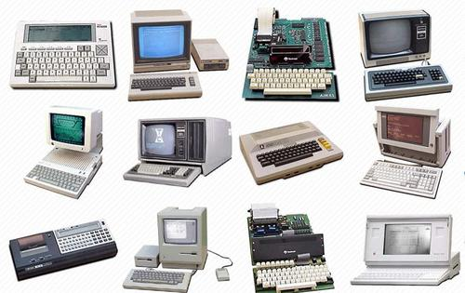
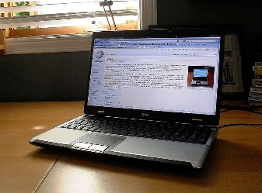

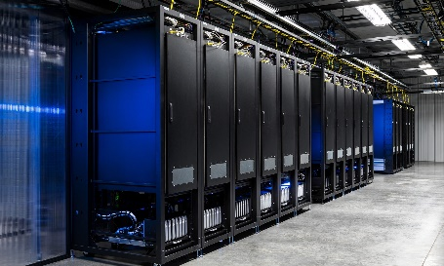
Do computers consume a lot of power?
We have moved from a few Watts to a few Megawatts ...

Slide 4

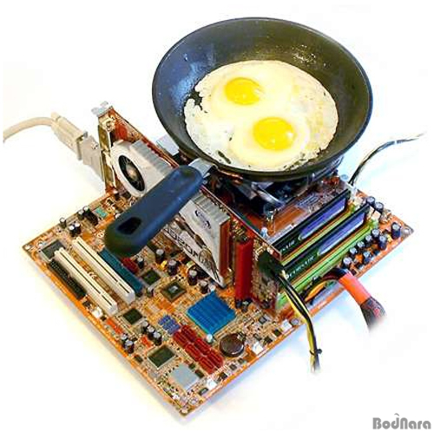
How hot do CPUs get?
This Photo by Unknown Author is licensed under CC BY-NC-ND

Slide 5

Why do we care?
High power consumption raises energy bills and cooling costs
Reduces the battery life
High power → high temperature
Causes an unpleasant experience in mobile phones
Increases fan noise (in desktops/ servers)
Decreases reliability
Cooling costs of a data center are 20-40% of the total energy consumption

Slide 6

Contents
1.
Power Consumption Model
2.
Temperature Model
3.
Power Management
4.
Temperature Management
AGENDA ITEM 06
Green marketing is a practice whereby companies seek to go above and beyond.

Slide 7
Types of Power Consumption
Power Consumption
Dynamic Power
Leakage Power

Slide 8
Dynamic Power

Slide 9
Consider an Inverter Pair
I₁
I₂
T₁
T₃
Input
Output
T₂
T₄
If the input maintains its value, then all the nodes in the circuit maintain their values (voltages). There is no flow of current.
There is a flow of current, only if a conducting path forms from V_{dd} to ground, or between the gate of T₃/T₄ and V_{dd}/ground (via T₁ and T₂, respectively).
Any flow of current leads to an I²R heat loss.

Slide 10
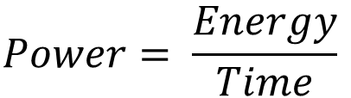
Dynamic Power Dissipation
No dynamic power is dissipated if the inputs maintain their values
The power dissipation is a function of the number of voltage transitions
Each leads to a passage of current and subsequent I²R heat loss
Power simulation tools estimate the number of 1 → 0 and 0 → 1 transitions in the circuit. Each transition has an energy cost.
$$Power= \frac{Energy}{Time}$$

Slide 11
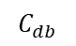
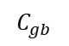
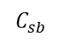
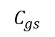
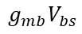
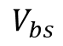
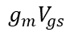
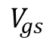
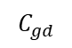
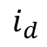
Basic Idea: Convert an Electronic Circuit into an RC Network
The equivalent circuit has resistors, capacitors, current, and voltage sources
Equivalent Circuit of an NMOS transistor
$$C_{gd}$$
$$i_{d}$$
+
gate
drain
$$V_{gs}$$
$$C_{gs}$$
$$C_{gb}$$
$$g_{m}V_{gs}$$
$$g_{mb}V_{bs}$$
-
-
source
$$V_{bs}$$
$$C_{sb}$$
+
$$C_{db}$$
body

Slide 12
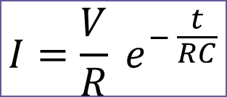
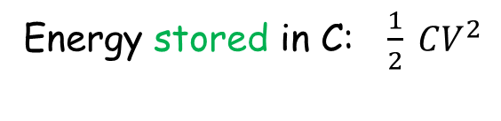
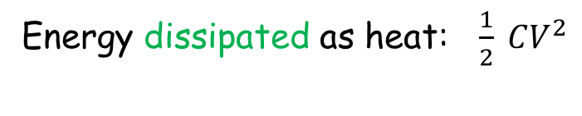
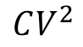
Simple Capacitor Charging and Discharging
switch (1)
V_{o}
R
V
switch (2)
C
Assume that at t = 0, we connect switch (1)
The capacitor gets charged
Total energy provided:
$$CV^{2}$$
Energy dissipated as heat: $\frac{1}{2} CV^{2}$
$$I=\frac{V}{R} e^{− \frac{t}{RC}}$$
Energy stored in C: $\frac{1}{2} CV^{2}$

Slide 13
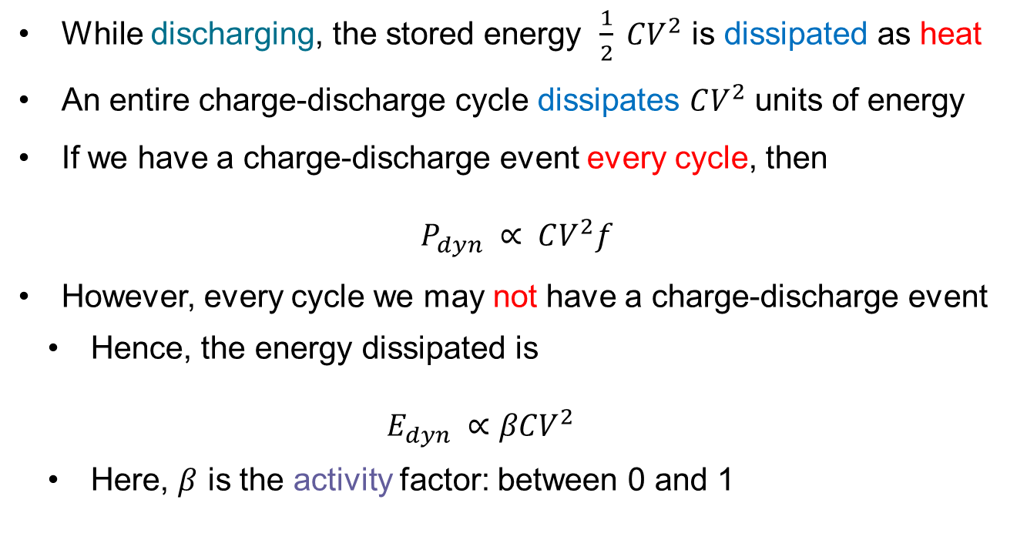
More about Capacitor (Dis)Charging
While discharging, the stored energy $\frac{1}{2} CV^{2}$ is dissipated as heat
An entire charge-discharge cycle dissipates $CV^{2}$ units of energy
If we have a charge-discharge event every cycle, then
$$P_{dyn} ∝ CV^{2}f$$
However, every cycle we may not have a charge-discharge event
Hence, the energy dissipated is $E_{dyn} ∝βCV^{2}$
Here, $β$ is the activity factor: between 0 and 1

Slide 14


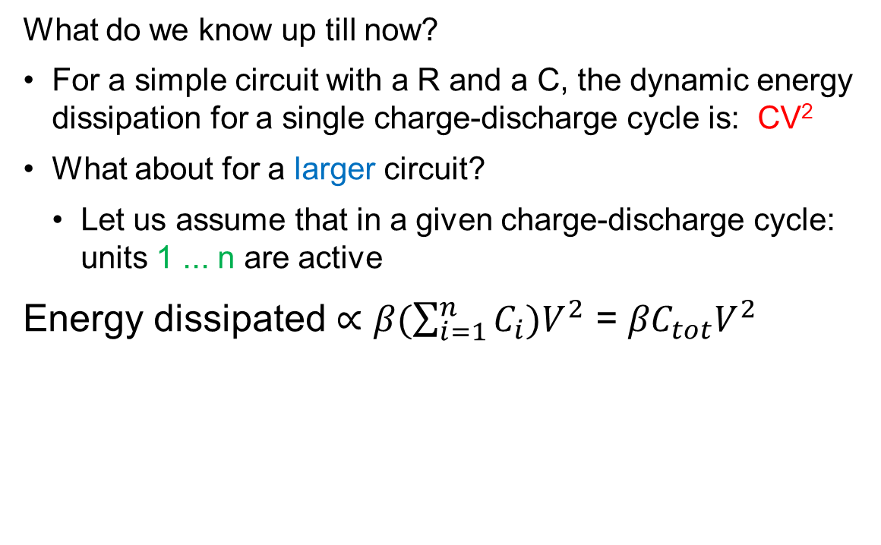

Dynamic Power Analysis
What do we know up till now?
For a simple circuit with a R and a C, the dynamic energy dissipation for a single charge-discharge cycle is: CV²
What about for a larger circuit?
Let us assume that in a given charge-discharge cycle: units 1 ... n are active
Energy dissipated $∝β(\sum_{i=1}^{n}{C_{i}})V^{2}$ = ${βC}_{tot}V^{2}$
$$P_{dyn} ∝βCV^{2}f$$

Slide 15
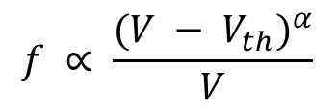
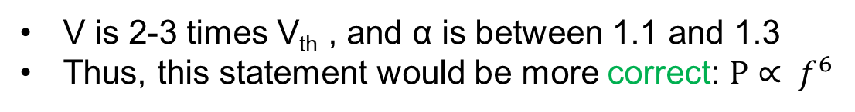
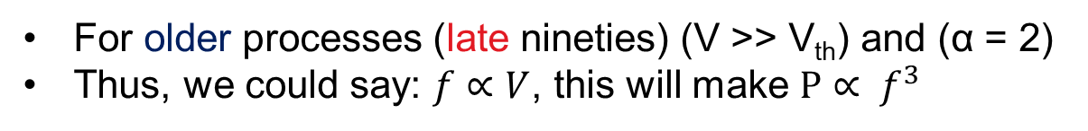
Relationship between V and f
Let us look at some textbook results.
Alpha Power Law
$$f ∝ \frac{(V − V_{th})^{α}}{V}$$
The good old days
For older processes (late nineties) (V >> V_{th}) and (α = 2)
Thus, we could say: $f∝V$, this will make $P∝ f^{3}$
Nowadays
V is 2-3 times V_{th} , and α is between 1.1 and 1.3
Thus, this statement would be more correct: $P∝ f^{6}$

Slide 16

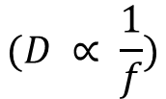

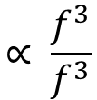
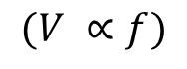
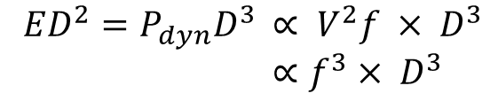
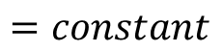
The $ED^{2}$ Metric
Let us say that we have two designs: A and B. As compared to design A,
B is 10% faster yet consumes 20% more energy. Which design is better?
$$ED^{2}=P_{dyn}D^{3 }∝ V^{2}f × D^{3}$$
$∝f^{3}× D^{3 }$
$$(V ∝f)$$
Old model
$$∝ \frac{f^{3}}{f^{3}}$$
$$(D ∝ \frac{1}{f})$$
Approximate
$$=constant$$
ED² is a fundamental property of the system.
It can be used to compare different designs.
In this case: ED² for B is 0.97 times the ED² of A

Slide 17
Short-Circuit Power
T₁
short
circuit
current
T₂
There is a brief period when both the transistors are conducting.
This is the short-circuit current.
Typically, 10% of the overall dynamic power

Slide 18
Leakage Power

Slide 19


Leakage (or static) power is any source of power dissipation that is not present in an ideal transistor.
Examples
No current should flow through the gate. However, there might be a small amount of leakage.
Same is the case for a transistor in the off state.

Slide 20
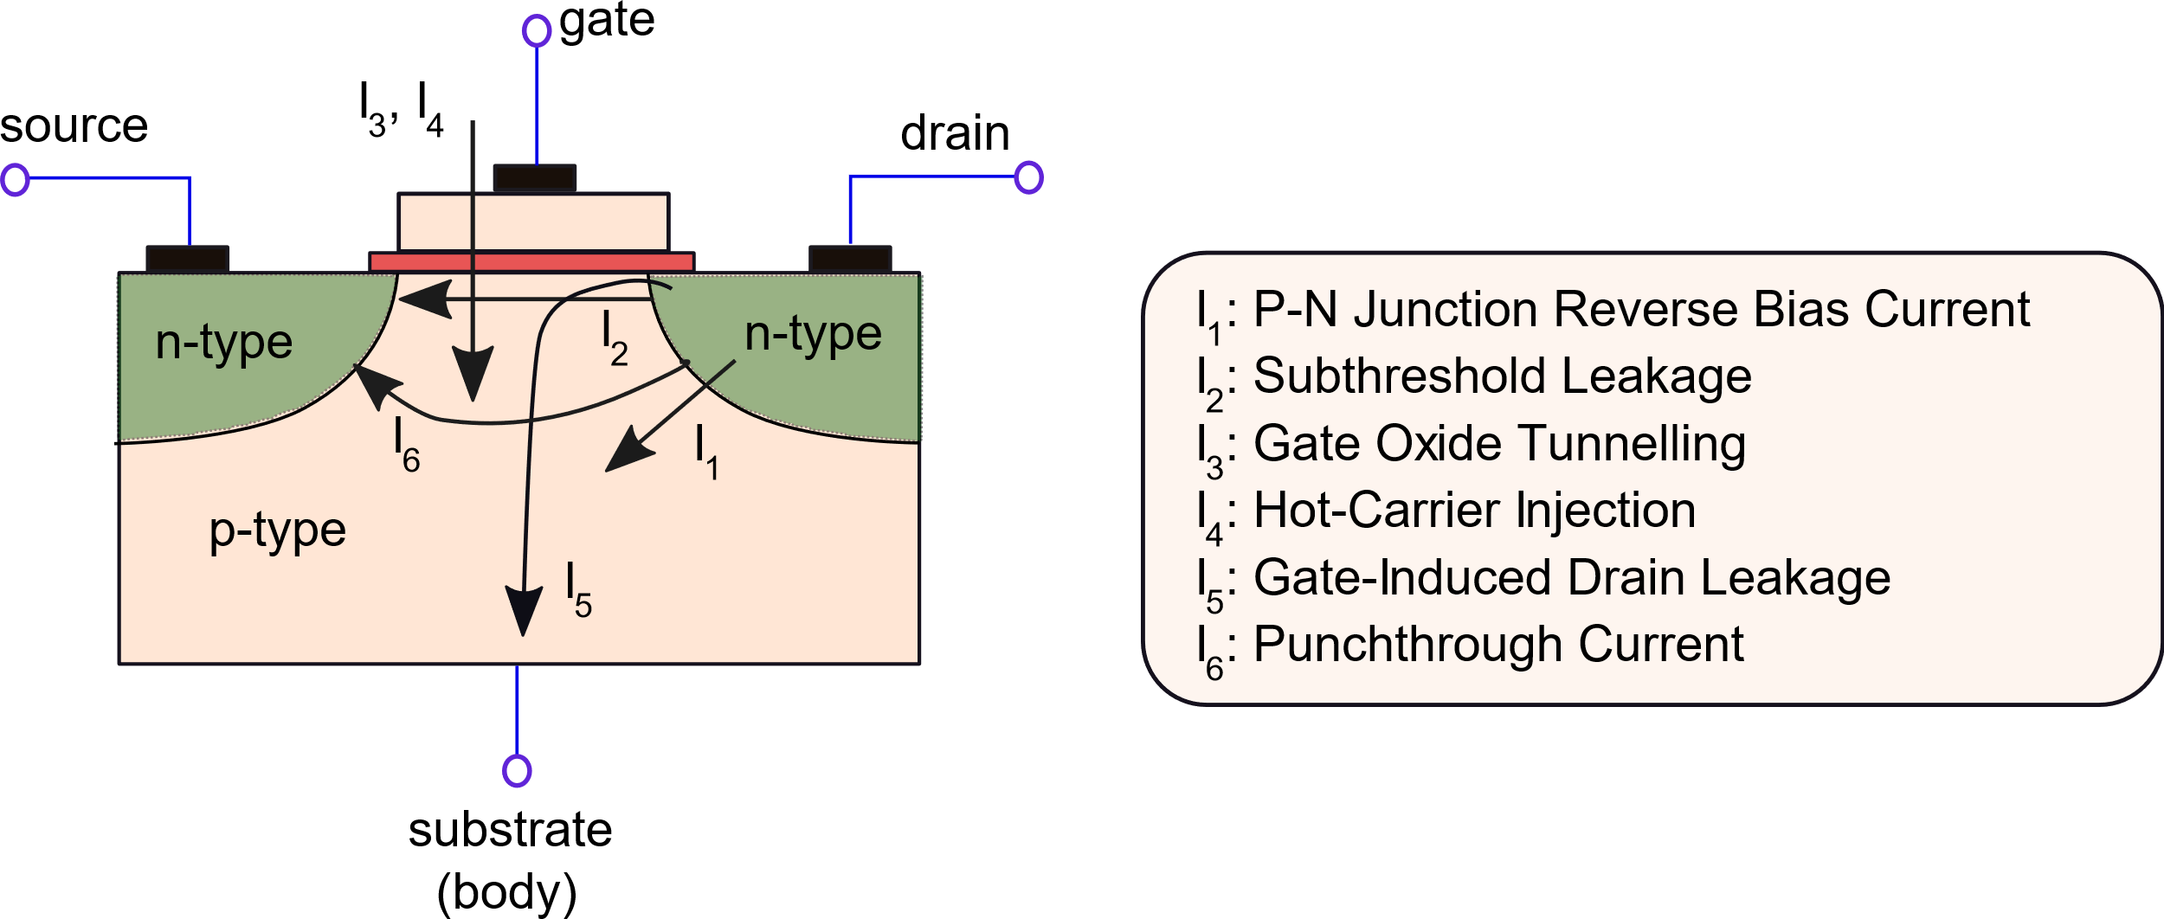

Major Leakage Mechanisms
Six different popular leakage mechanisms

Slide 21
I₁: P-N Junction Reverse Bias Current
drain
n-type
p-type
substrate
The p side is connected to a low voltage source and the n side is connected to a high voltage source
Typical scenario in an NMOS transistor (reverse bias)
Main leakage mechanism: Band-to-band Tunnelling (BTBT)

Slide 22
Band-to-band Tunnelling (BTBT)
Conduction band
Electron energy
Fermi level
Valence band
Metal
Semiconductor
Insulator
Electrons can only occupy a fixed set of energy levels
For doped semiconductors, the Fermi level separates the valence and conduction bands
Electrons can act as charge carriers only in the conduction band
A high electric field forces electrons to tunnel from the valence band of the p-typed region to the conduction band of the n-typed region

Slide 23
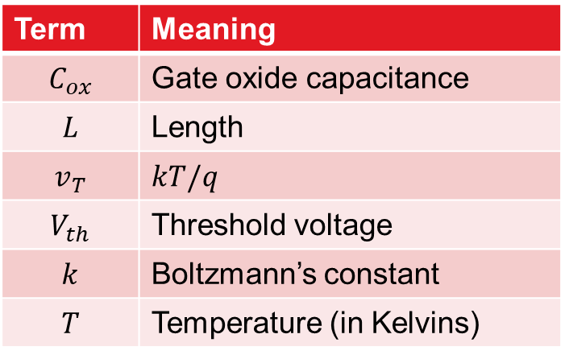
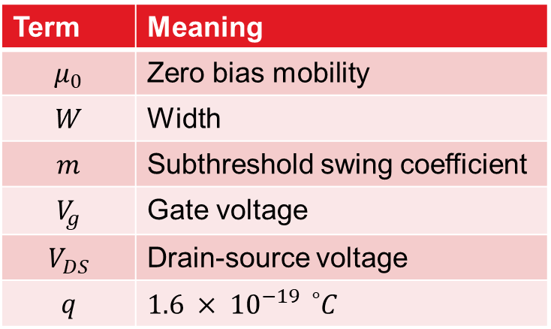
I₂: Subthreshold Leakage
The gate voltage needs to be lower than the threshold voltage
A tiny amount of current still flows from the drain to the source
$$I_{ds}= μ_{0}C_{ox}\frac{W}{L}\left(m−1\right)v_{T}^{2} ×e^{(V_{g} − V_{th})/(mv_{T})}×\left(1 − e^{−\frac{V_{DS}}{v_{T}}}\right)$$
Term | Meaning
$$μ_{0}$$ | Zero bias mobility
$$W$$ | Width
$$m$$ | Subthreshold swing coefficient
$$V_{g}$$ | Gate voltage
$$V_{DS}$$ | Drain-source voltage
$$q$$ | $$1.6 × {10}^{−19}{}_{}^{∘}C$$
Term | Meaning
$$C_{ox}$$ | Gate oxide capacitance
$$L$$ | Length
$$v_{T}$$ | $$kT/q$$
$$V_{th}$$ | Threshold voltage
$$k$$ | Boltzmann’s constant
$$T$$ | Temperature (in Kelvins)

Slide 24


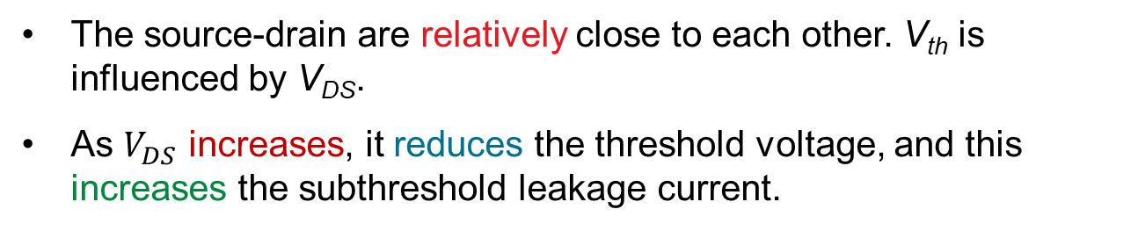
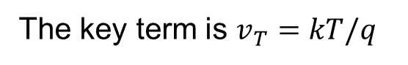
More about Subthreshold Leakage
The relationship between the subthreshold leakage current and the temperature has been a subject of extensive study.
The key term is $v_{T}=kT/q$
The dependence is theoretically exponential.
However, in the 40-80 °C range, a linear, piecewise linear, or quadratic assumption is good enough
Short-channel devices
The source-drain are relatively close to each other. V_{th} is influenced by V_{DS}.
As $V_{DS}$ increases, it reduces the threshold voltage, and this increases the subthreshold leakage current.

Slide 25


I₃: Gate Oxide Tunnelling
The gate oxide is very thin (<2 nm)
Increases the electric field
Since the oxide layer is so thin, charge carriers tunnel through the thin gate oxide
Fowler-Nordheim Tunnelling: Electrons move into the conduction band of the oxide layer because of an external electric field.
DirectTunnelling: Electrons directly tunnel from the surface of the silicon layer to the gate.

Slide 26

I₄: Hot-Carrier Injection
Electrons escape across the Si-SiO₂ interface
In the case of a positively charged gate
Some electrons can move from the substrate to the gate
This is not quantum mechanical tunnelling → just plain old kinetic energy

Slide 27
I₅: Gate-Induced Drain Leakage (GIDL)
gate
source
drain
n-type
n-type
Hole accumulation
p-type
substrate
Condition: Gate-to-drain voltage < 0
Positively charged holes migrate towards the gate oxide layer and accumulate there
Holes migrate into the substrate. Causes a current flow from the drain to the substrate.

Slide 28
I₆: Punchthrough Current
gate
source
drain
n-type
n-type
p-type
substrate
Consider transistors with short channels
Possible that the drain-substrate and source-substrate interfaces are reverse biased
The depletion regions can merge
Basically, now the drain and source are connected by a depletion region
Creates a new conductive path that is poorly controlled by the gate

Slide 29
Ballpark Figures
Dynamic Power
Major component
50-70%
Short Circuit Power
Small (insignificant)
5-10%
Leakage Power
Managed at operating temperatures
20-30%

Slide 30
Contents
1.
Power Consumption Model
2.
Temperature Model
3.
Power Management
4.
Temperature Management
AGENDA ITEM 06
Green marketing is a practice whereby companies seek to go above and beyond.

Slide 31
Diagram of a Silicon Chip Package
Heat
flow
Heat sink
Heat spreader
Heat spreader
Silicon chip
PCB
Most of the heat flows vertically through the heat sink (to the ambient)
The heat spreader homogenizes the temperature profile (made of a Ni-Cu alloy)
The heat sink has a large surface area
Lateral heat conduction and flow through the PCB account for 20-30% of the total heat flow (typically)

Slide 32
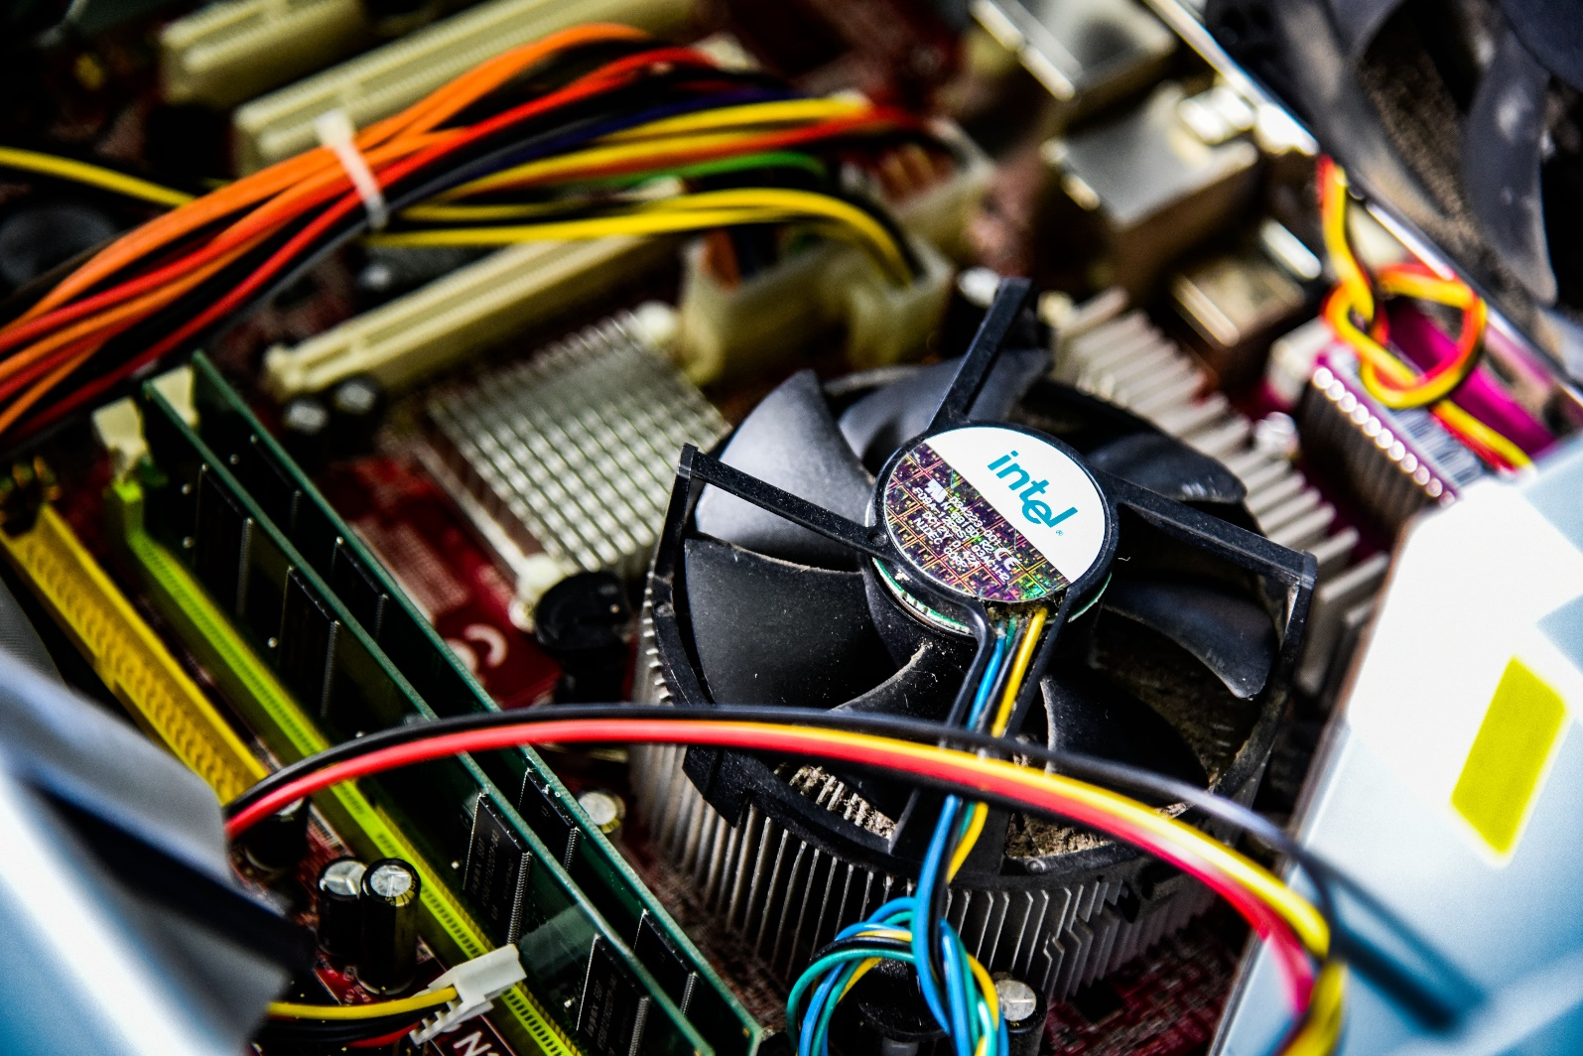
Chip Package (Heat Sink and Fan)
Photo by Zane Lee on Unsplash

Slide 33
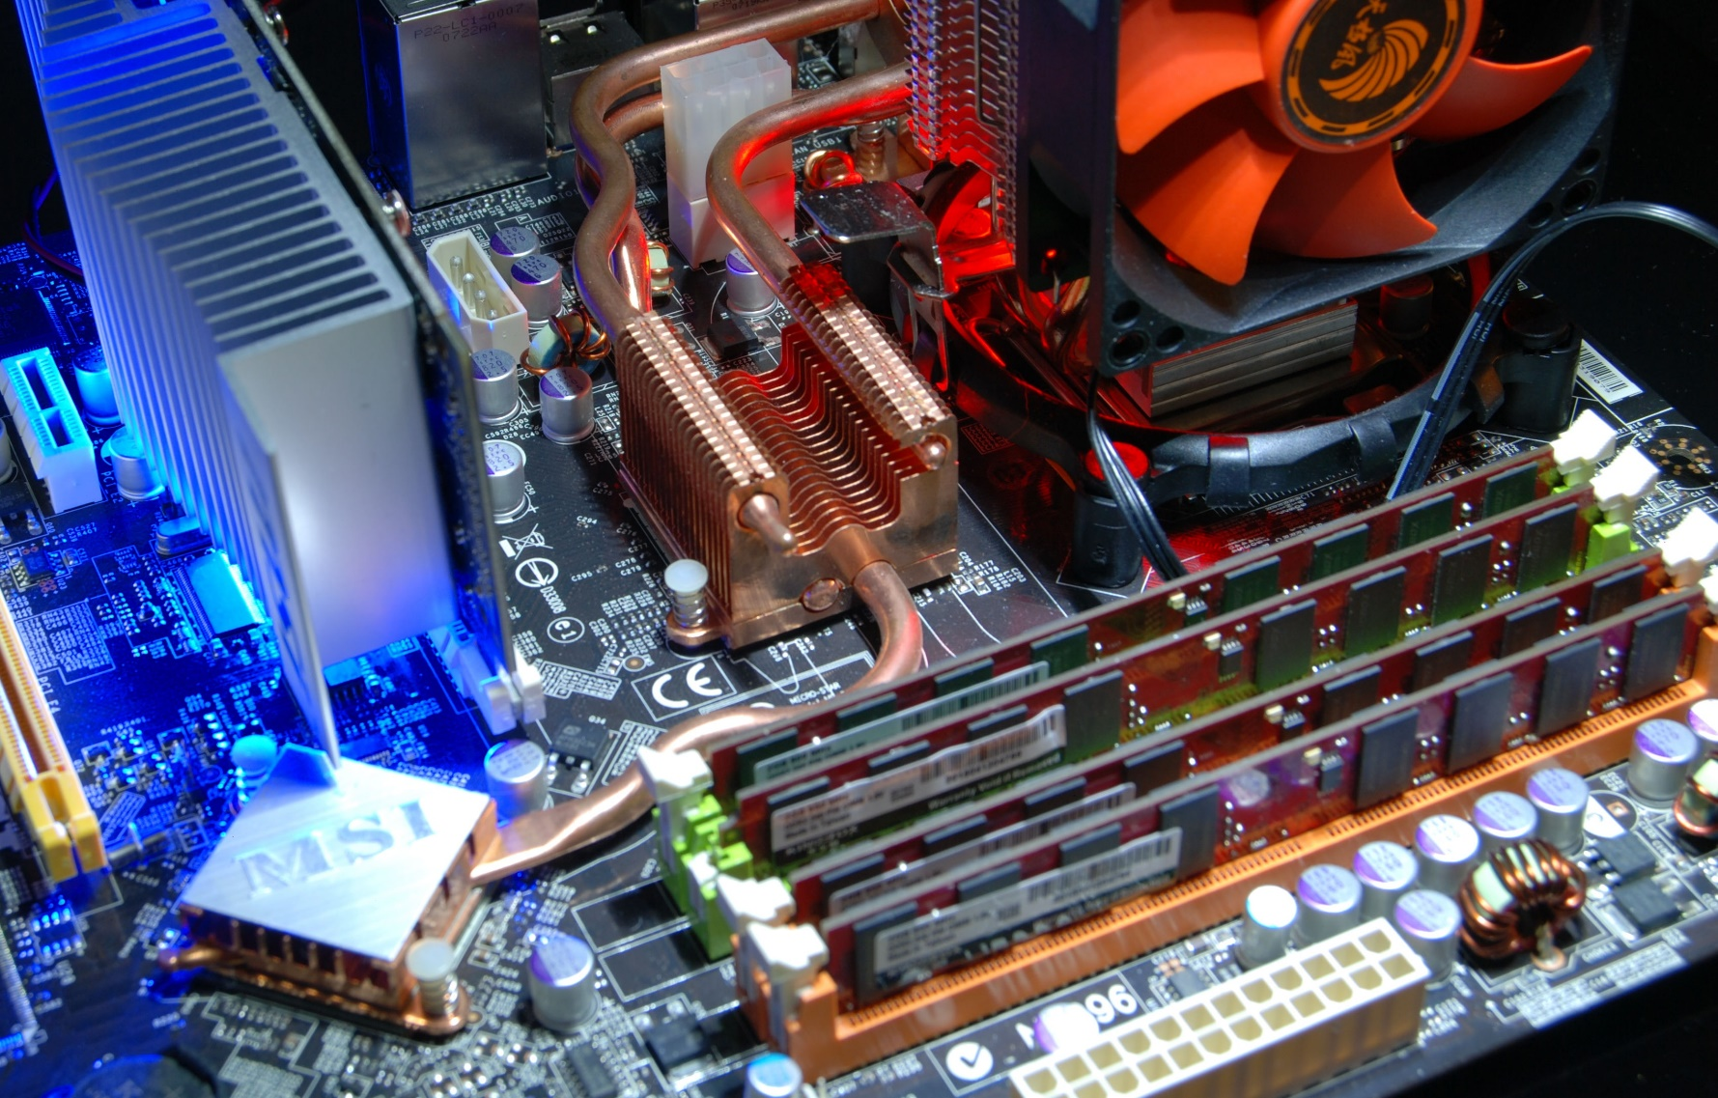
The Motherboard
Photo by Jim Varga on Unsplash

Slide 34
Three Heat Transfer Mechanisms
Conduction
Convection
Radiation
Need contact
Dissipated by the movement of fluids
Dissipated as EM waves

Slide 35
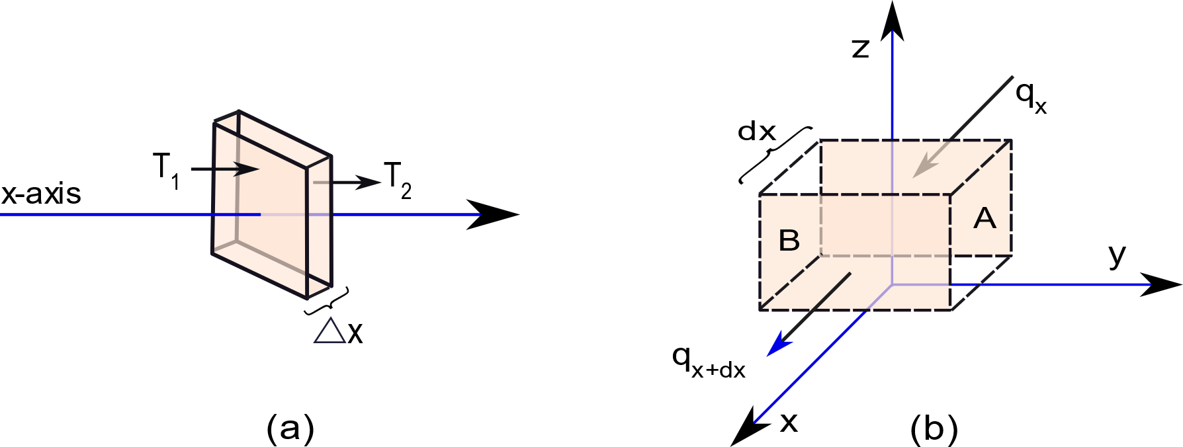


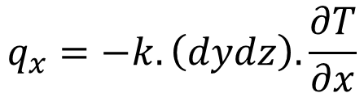
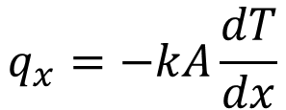
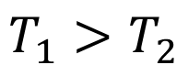
Some Basic Physics
Power (in Watts)
$$T_{1}>T_{2}$$
3D view
Area of a face: A
$$q_{x}=−kA\frac{dT}{dx}$$
Fourier’s Law of Heat Conduction
$$q_{x}=−k.\left(dydz\right).\frac{∂T}{∂x}$$
3D version

Slide 36

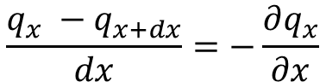
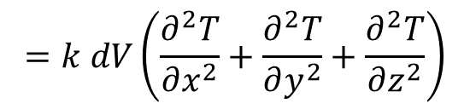
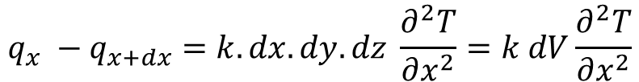
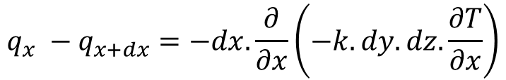
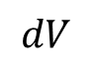
A Little Bit of Algebra
$$\frac{q_{x} −q_{x+dx}}{dx}=−\frac{∂q_{x}}{∂x}$$
Heat (in W) that remains within the volume
(x-axis)
$$q_{x} −q_{x+dx}=−dx.\frac{∂}{∂x}\left(−k.dy.dz.\frac{∂T}{∂x}\right)$$
$$q_{x} −q_{x+dx}=k.dx.dy.dz \frac{∂^{2}T}{∂x^{2}}=k dV\frac{∂^{2}T}{∂x^{2}}$$
$$dV$$
Total heat that remains within the volume, dV
$$=k dV\left(\frac{∂^{2}T}{∂x^{2}}+\frac{∂^{2}T}{∂y^{2}}+\frac{∂^{2}T}{∂z^{2}}\right)$$

Slide 37

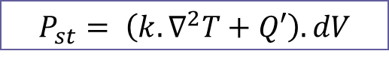
Some More Algebra
Definition
$$\left(\frac{∂^{2}}{∂x^{2}}+\frac{∂^{2}}{∂y^{2}}+\frac{∂^{2}}{∂z^{2}}\right)= ∇^{2}$$
Total heat that remains within the volume, dV
$$=k.dV.∇^{2}T$$
Rate of internal heat generation for the given volume
Q’
<Total thermal power that enters> + <is generated> within the volume dV
$$P_{st}= \left(k.∇^{2}T+Q′\right).dV$$

Slide 38
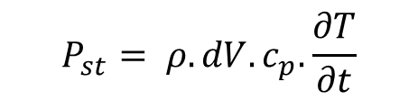
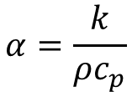
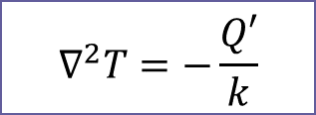
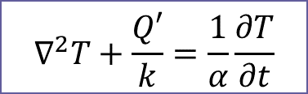

Another way of looking at P_{st}
The stored power increases the temperature of dV
$$P_{st}= ρ.dV.c_{p}.\frac{∂T}{∂t}$$
density
specific heat
Rate of temperature rise
Equating both the expressions of P_{st}
$$k∇^{2}T+Q^{′}=(ρc_{p})\frac{∂T}{∂t}$$
Equating the time derivative and second-order spatial derivatives
$$∇^{2}T+\frac{Q′}{k}=\frac{1}{α}\frac{∂T}{∂t}$$
$$α=\frac{k}{ρc_{p}}$$
$$∇^{2}T=−\frac{Q′}{k}$$
Steady state profile

Slide 39




How do we solve the Fourier equation?
Answer:
We can use the Finite Difference Method (FDM). Convert the partial differential equation into a regular system of linear equations.
${\left.\frac{∂^{2}T}{∂x^{2}}\right|}_{i,t}≈ \frac{{\left.\frac{∂T}{∂x}\right|}_{i+1,t} − {\left.\frac{∂T}{∂x}\right|}_{i,t}}{∆x}$
For element i at time t, we are creating an algebraic equation
$≈ \frac{\frac{T_{i+1,t} − T_{i,t}}{∆x} − \frac{T_{i,t} − T_{i−1,t}}{∆x}}{∆x}$
$= \frac{T_{i+1,t} −2T_{i,t}+ T_{i−1,t}}{∆x^{2}}$

Slide 40


Steady State Solution
$$∇^{2}T=−\frac{Q′}{k}$$
Steady state Fourier’s equation
This can be converted to a set of linear equations (we can consider all three axes: x, y, and z). We will finally get →
$$T=AP$$
Linear transformation
Discretize a chip into a grid of N cells
Two N-element vectors: T (temperature) and P (power)
N x N matrix A (derived from the principles shown in the previous slide)

Slide 41




Transient Solution
$$k∇^{2}T+Q^{′}=\frac{k}{α}\frac{∂T}{∂t}$$
Transient form
$k∇^{2}T$ → Linear transformation
Let us refer to the time derivative of T as T’
G and C are N x N element matrices
$$GT+P=CT′$$
Matrix form of the equation
Second derivative → linear transformation
Time derivative
Solve this equation for all time steps:
For the k^{th} time step: $T^{′}=(T_{k+1}− T_{k})/Δt$
Power
vector

Slide 42


Electrical Analog of the Problem
$$GT+P=CT′$$
Replace temperature with voltage and power with current
The matrix G is the conductance matrix: relates voltage to current
$T′$ stands for the derivative of temperature (voltage)
Consider a capacitor. I (current/power) = C dV/dt
The C matrix thus stands for thermal capacitance
Thermal problem
Electrical problem

Slide 43
Electrical Analog
Add thermal resistances between grid cells
Capacitors are added to ground
Solve for the voltages using a regular circuit simulator
Map the solved voltages to temperatures

Slide 44





Finite Element Method (FEM)
Accurate yet slow
Convert the differential equation into an integral equation. Multiply the original differential equation with a test function, v().
Divide the domain into a set of triangles, rectangles, cuboids or tetrahedrons. Each such basic structure is an element. The points at which elements are connected as nodes.
Create a set of algebraic equations.
f_{k} is the value of f(x) (function to be computed) at node k
Let v_{k}(x) be a basis function corresponding to node k
Let us express:
$$f\left(x\right)=Σ_{k=1}^{n}f_{k}v_{k}(x)$$
$$f_{1},v_{1}(x)$$
$$f\left(x\right)=f_{1}v_{1}\left(x\right)+f_{2}v_{2}\left(x\right)$$ $+f_{3}v_{3}(x)$
Express as a system of linear equations and solve
$$f_{3},v_{3}(x)$$
$$f_{2},v_{2}(x)$$

Slide 45

Green’s Functions
FEM and FDM are very slow.
1
Linearity and Superposition
If the total power profile is P = P_{x}+ P_{y}, the final thermal profile is T = T_{x} + T_{y}
2
Shift Invariance
For large parts of the chip, the effect of a small power source on its immediate neighborhood is the same.
Exceptions: The rim and corners
Divide the chip into an NxN grid
Let us apply 1W of power at the point (x_{p}, y_{q}) (function G)
G(x,y) is radially symmetric.
This means G(x,y) = G(-x,-y)

Slide 46



Green’s Functions
Add the effect of all power sources
Using the properties of linearity and shift invariance
Green’s function
$T\left(x_{p},y_{q}\right)=Σ_{i=1}^{N}Σ_{j=1}^{N}P\left(x_{i},y_{j}\right)G(x_{p}−x_{i},y_{q} − y_{j})$
Continuous
form
$$T\left(x^{′},y^{′}\right)= \int_{x}{\int_{y}{P\left(x,y\right).G\left(x^{′}−x,y^{′}−y\right).dx.dy}}$$
Each power source reduces to the Dirac delta function (impulse)
$$\int{δ\left(x\right).dx}=1$$
Its value is 0 at all points other than the origin
This is nothing but the 2D convolution operation
Green’s function
$$T=P ⋆ G$$

Slide 47



Green’s Function
Green’s function
Power profile
Temperature profile
This is a much faster operation than conventional vector-matrix multiplication. O(n²) → O(n) (quadratic to linear)

Slide 48

Leakage Temperature Feedback Loop
Needs several iterations to converge
Dynamic + Short Circuit Power
Total Power
Temperature
Leakage Power
Can we compute a leakage-aware Green’s function?

Slide 49
Contents
1.
Power Consumption Model
2.
Temperature Model
3.
Power Management
4.
Temperature Management
AGENDA ITEM 06
Green marketing is a practice whereby companies seek to go above and beyond.

Slide 50
DVFS – Dynamic Voltage Frequency Scaling
CPUs can run with different voltage-frequency configurations
Increasing frequency → increasing voltage
Most processors use a DVFS table
Frequency | Voltage
1.6 GHz | 1.484 V
1.4 GHz | 1.420 V
1.2 GHz | 1.276 V
1.0 GHz | 1.164 V
0.8 GHz | 1.036 V
0.6 GHz | 0.956 V
Can be HW controlled
SW controlled, cpufreq utility on Linux
DVFS table, Intel Pentium M processor

Slide 51

Chip’s Power Grid and Frequency Control System
CPU
Power Supply
3.3V
Voltage Regulator
0.8-1.2V
Quartz clock
PLLs
The quartz clock generates a fixed 133 MHz signal
PLL → phase locked loop
It helps generate a clock signal that is synchronized with the quartz clock
The frequency is a multiple of 133 MHz
For example, we can use it to generate a frequency of 133 MHz * 16 = 2.13 GHz

Slide 52

Changing Voltage and Frequency
$$≈10−20 μs$$
PLL lock time
PLL lock time
Operation
Steady state
V1
V0
Voltage
Voltage conversion
Voltage conversion

Slide 53


Hardware-based DVFS
Estimate the amount of CPU activity
If it is low, then reduce the frequency
If it is high, then increase the frequency
Measure the power consumption and temperature
If they are low, then increase the frequency
If they are high, then reduce the frequency

Slide 54
Software-based DVFS
Video Codecs
Each frame needs to be processed in 33 ms
If we can do it in 20 ms
Reduce the frequency till we process it in 33 ms
Need a model to relate processing time and frequency
Regular programs
Classify them: hard real time, soft real time, interactive, periodic, batch
Real time tasks → set DVFS settings based on performance and deadlines
Interactive → Take the user’s perception into account
Periodic jobs → Take the periodicity into account
Batch → Take the user’s requirements into account

Slide 55
Linux Speed Governor
Linux cpufreq utility
Performance → maximum possible frequency
Powersave → always run at minimum frequency
Ondemand → Tries to maintain a constant rate of CPU utilization. Uses a set of thresholds for each DVFS setting.
Conservative → Much more conservative than ondemand
Interactive → Similar to Ondemand but does not use thresholds. Uses a formula that relates CPU utilization to frequency.

Slide 56


Clock Gating
Functional
unit
Clk
Clk
gate
Clk input
Dynamic power is dissipated because of voltage transitions
The best way to stop transitions and disable a circuit is by disabling the clock
Set it to 0
Predict if a unit will be idle in the future. Gate its clock.
Use past history
Forecast in the decode stage

Slide 57

Correctness Problems
How do we verify such a circuit?
Answer:
In a lot of designs, the internal states with and without clock gating need to be identical. Much easier to verify
Does it introduce spurious clock edges?
Answer:
If the clock is at 1, and we gate it, we introduce a premature 1→ 0 transition. This condition has to be avoided.

Slide 58
Clock Gating Example
Carry lookahead adder
Block 16
Block 1
32
31
30
29
4
3
2
1
G,P
G,P
G,P
G,P
32-31
30-29
4-3
2-1
G,P
G,P
Assume bit #4 changes
Only the small part of the circuit shown in red is affected.
The rest of the elements do not dissipate any dynamic power.
They can be clock gated.
32-29
4-1
G,P
G,P
G,P
G,P
32-25
24-17
16-9
8-1
G,P
G,P
32-17
16-1
G,P
32-1

Slide 59
Issue and Fetch Throttling
This is a power vs IPC tradeoff
The fetch rate and issue rate can be dynamically adjusted based on the dynamic power that is being dissipated
This will reduce the IPC (use a feedback-based mechanism)
However, there will be a point till which the reduction in IPC is acceptable (given that P_{dyn} is reducing)

Slide 60
Reducing Leakage Power: Power Gating
Power grid
Power grid
Sleep trans.
Sleep trans.
Ground grid
Ground grid
Use transistors to turn off the supply.
We can have two transistors for each island of transistors: connected to the power grid and ground grid
If a circuit is unused, power-gate it: Zero leakage power

Slide 61
Issues to Keep in Mind
The current available to the functional units (FUs) after adding the sleep transistors.
Large sleep transistors take time to switch on and off. The FU is unusable during this time.
There will be some leakage through the sleep transistors (not much though).
Abrupt changes in the current usage may destabilize the power and ground grids → add decoupling capacitors
Sleep transistors will effectively reduce the supply voltage and raise the ground voltage.
We have to predict well in advance about when a certain FU is unused and can be power gated.
A power-gated FU loses its state.

Slide 62


Use Multiple Transistor Sizes
Compare
Transistors with shorter channels and transistors with longer channels
Normal transistors: power → 1 unit, time → 1 unit
Longer channel transistors: power → 0.3 units, time → 1.1 units
Use normal transistors on the critical path, and slower transistors off the critical path (save power)
Gate sizing
Delay $∝A+B/W$ , Power $∝W$ (W → Width of the transistor)
Slower transistors: smaller W/L ratio (L → Length of the channel)
Same idea: Slower transistors off the critical path, Faster transistors on the critical path.

Slide 63


Adaptive Body Biasing
V_{th} = V_{th0} – K1 ⋅ V_{dd} – K2 ⋅ V_{bs}
The threshold voltage is dependent on the supply voltage and the source-body voltage
Forward body biasing → Increase V_{bs}
Reduce V_{th}
Increase leakage power, increase switching speed
Reverse body biasing → Decrease V_{bs} (even –ve)
Increase V_{th}
Decrease leakage power, decrease switching speed
Same idea: forward body biasing in the critical path, reverse body biasing off the critical path

Slide 64

Drowsy Caches
Drowsy mode
Maintain the value, accesses not allowed
Allows read/writes
V_{dd} = 1V
V_{dd} = 0.3 V
Row of SRAM cells
Row of SRAM cells
Drowsy mode → Runs at 0.3 V. Maintains the value. Accesses are not allowed
Takes 1-2 cycles to enter/exit drowsy mode (access time increases)
Treat a set of lines as 1 unit
Turn it on/off as 1 unit
Once a set is turned on → Keep it on for 1000-2000 cycles
Take temporal and spatial locality into account

Slide 65
Circuit Diagram
Drowsy signal
Switch between
low voltage (V_{dd-low})
and high voltage (V_{dd})
T1
Latch
Power line
Drowsy
V_{dd-low}
T3
V_{dd}
T4
Drowsy
Word line (WL)
T2
Word line (WLE) enable
Drowsy signal = 1, WLE = 0 → T1 is on, T2 is off, T3 is on, T4 is off, Power line = V_{dd-low} , WL = 0
Drowsy signal = 0, WLE = 1 → T1 is off, T2 is on, T3 is off, T4 is on, Power line = V_{dd}, WL = 1
drowsy mode

Slide 66
Contents
1.
Power Consumption Model
2.
Temperature Model
3.
Power Management
4.
Temperature Management
AGENDA ITEM 06
Green marketing is a practice whereby companies seek to go above and beyond.

Slide 67



Dynamic Thermal Management
Place thermal sensors all over the chip
Once a temperature hotspot forms
Traditional mechanisms: DVFS, power reduction, fetch throttling
Stop-n-go
Temporarily stop a core (let it cool down)
Heat and run thread assignment
Don’t allow hot cores to be close to each other
If a thread’s activity increases, migrate it to a colder region of the chip (leakage is (slightly) a nonlinear function of temperature)

Slide 68
Temperature-Aware Task Mapping
It is not a good idea to have two cores nearby
There will be lateral heat conduction leading to higher temperature
Leakage increases nonlinearly with temperature
The spreader finds it hard to dissipate and distribute the heat
Optimization problem: Minimize the peak temperature subject to performance constraints.

Slide 69
Conclusion
The major power consumption mechanisms in modern CPUs are dynamic power and leakage power
Dynamic power consumption is proportional to the number of state transitions.
Leakage power is dissipated at non-ideal interfaces: there is current
flow when there should be none.
Temperature is modeled using the Fourier’s heat conduction
equations using the FEM, FDM, and Green’s functions
Power consumption can be reduced using a combination
of DVFS, clock gating, power gating, and throttling

Slide 70
The End

